Slide 1


LiveReview
Find the
danger.
Rank the risk. Enforce the standard. Keep the code yours.
01
ATTENTION
02
CONSISTENCY
03
CONTROL

Slide 2
LiveReview
ACT 01 — ATTENTION
THE PROBLEM
AI lets your team produce more code than it
can inspect.

Slide 3
LiveReview
ACT 01 — ATTENTION
THE PROBLEM
AI lets your team produce more code than it
can inspect.
THE QUESTION
So which changes deserve your engineers' scarce attention?

Slide 4
LiveReview
ACT 01 — ATTENTION
THE PROBLEM
AI lets your team produce more code than it
can inspect.
THE QUESTION
So which changes deserve your engineers' scarce attention?
LIVEREVIEW
LiveReview ranks every hunk by blast radius and review priority.

Slide 5
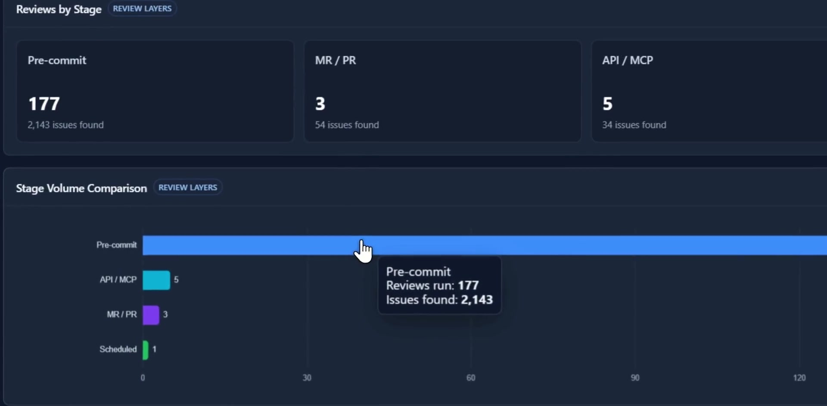
LiveReview
ACT 01 — ATTENTION
Every review, one
dashboard
Volume, issue mix and quality trends across
every stage a review can run at.
177 pre-commit reviews
2,143 issues found
3 merge / pull requests
54 issues found
5 API / MCP runs
34 issues found

Slide 6
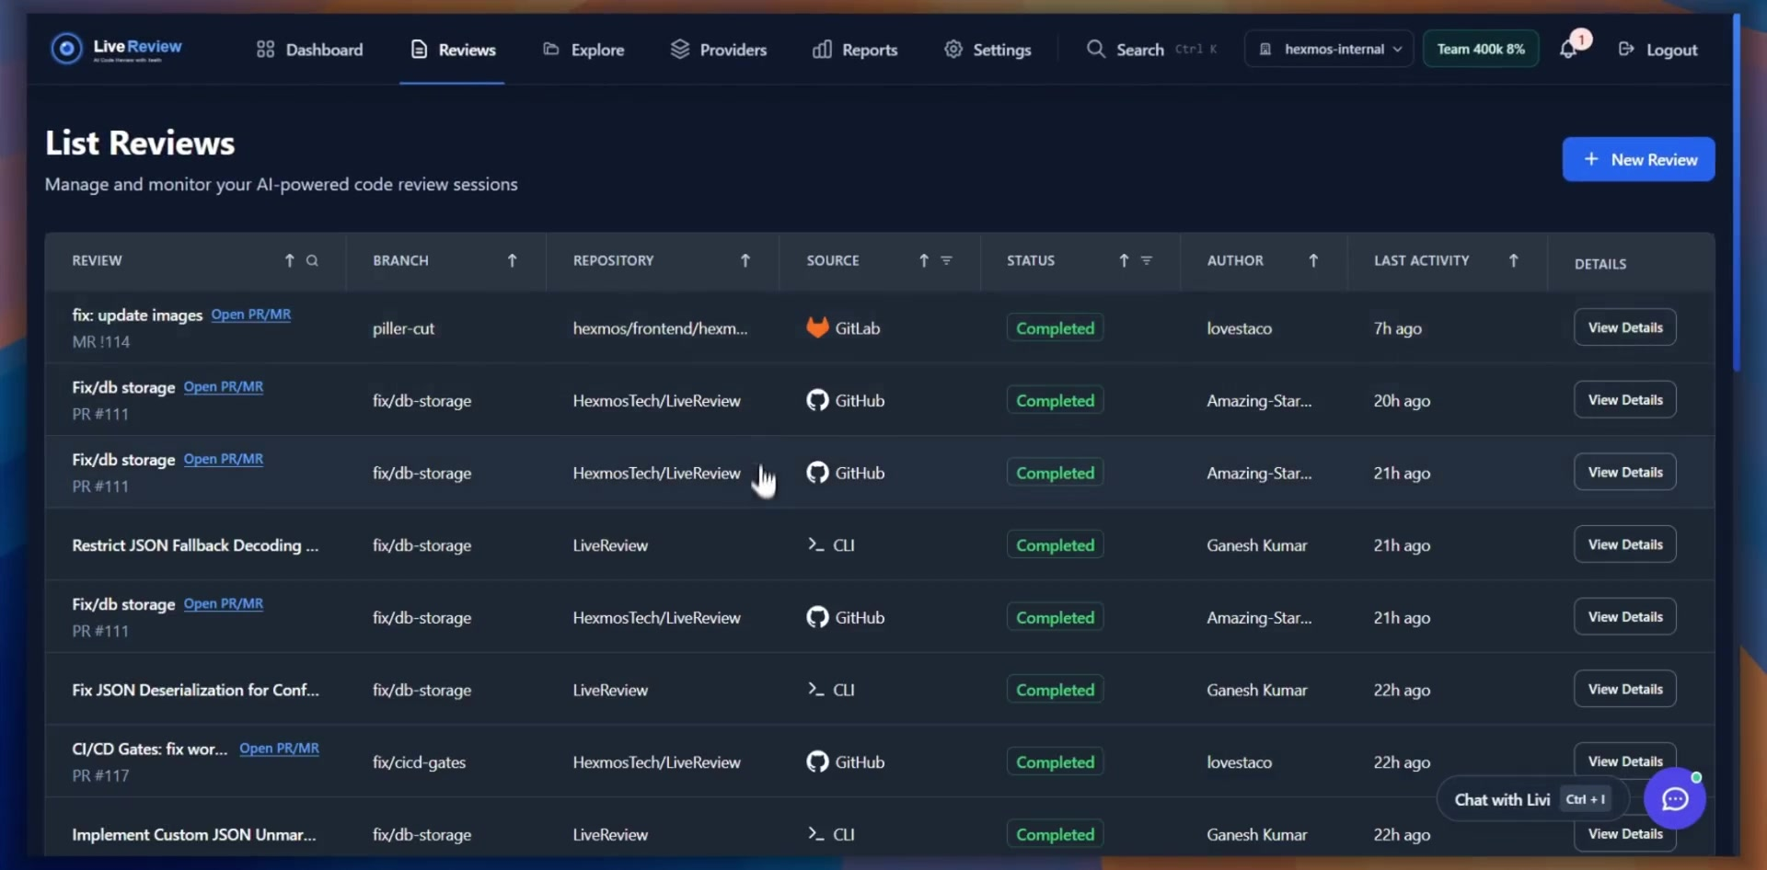
LiveReview
ACT 01 — ATTENTION
Every run lands in one queue
Branch, repository, source and status for each review — GitHub, GitLab, or straight from the CLI.

Slide 7
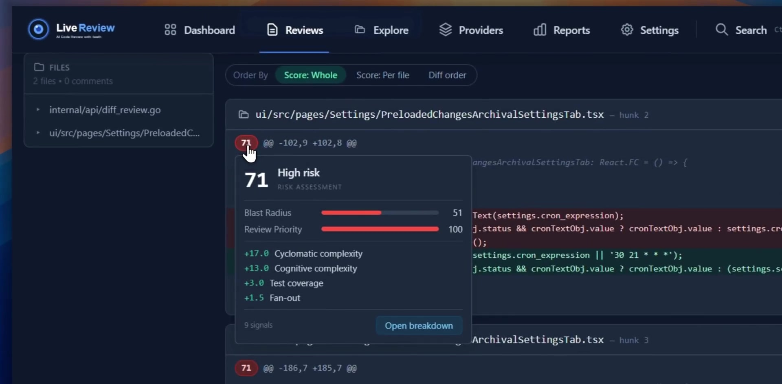
LiveReview
ACT 01 — ATTENTION
Blast radius tells you
what to read first
Each hunk is scored from measurable
signals, so the riskiest change sits at the top
of the review.
Risk 71 — high
blast radius 51, review priority 100
9 signals, all visible
complexity, test coverage, fan-out
Open breakdown
see exactly why a hunk scored

Slide 8
LiveReview
ACT 02 — CONSISTENCY
THE PROBLEM
A standard is useless when every engineer
must remember to enforce it.

Slide 9
LiveReview
ACT 02 — CONSISTENCY
THE PROBLEM
A standard is useless when every engineer
must remember to enforce it.
THE QUESTION
How do you make good review happen every time without
slowing the team down?

Slide 10
LiveReview
ACT 02 — CONSISTENCY
THE PROBLEM
A standard is useless when every engineer
must remember to enforce it.
THE QUESTION
How do you make good review happen every time without
slowing the team down?
LIVEREVIEW
LiveReview reviews at commit, push, PR, CI/CD, and on schedule,
enforcing your rules.

Slide 11
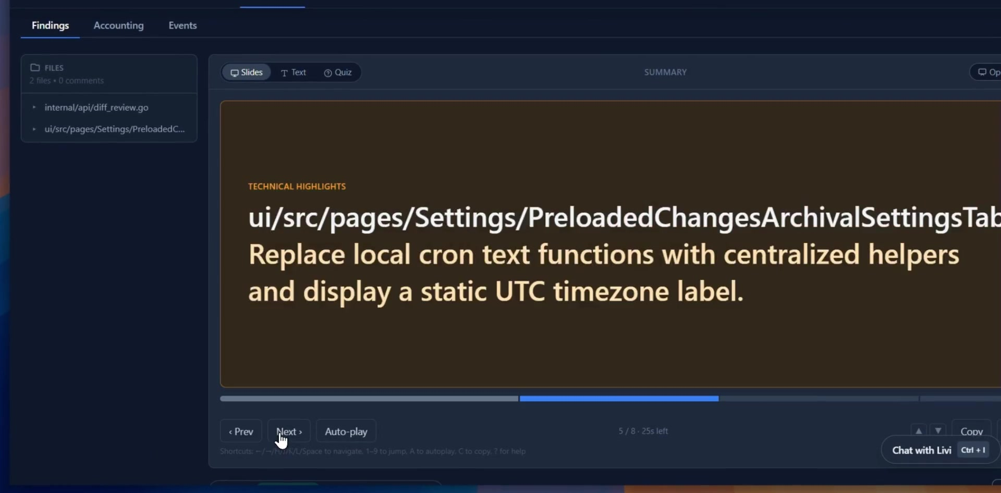
LiveReview
ACT 02 — CONSISTENCY
The review reads like a briefing
Findings become slides — technical highlights per file, with auto-play for a walkthrough.

Slide 12
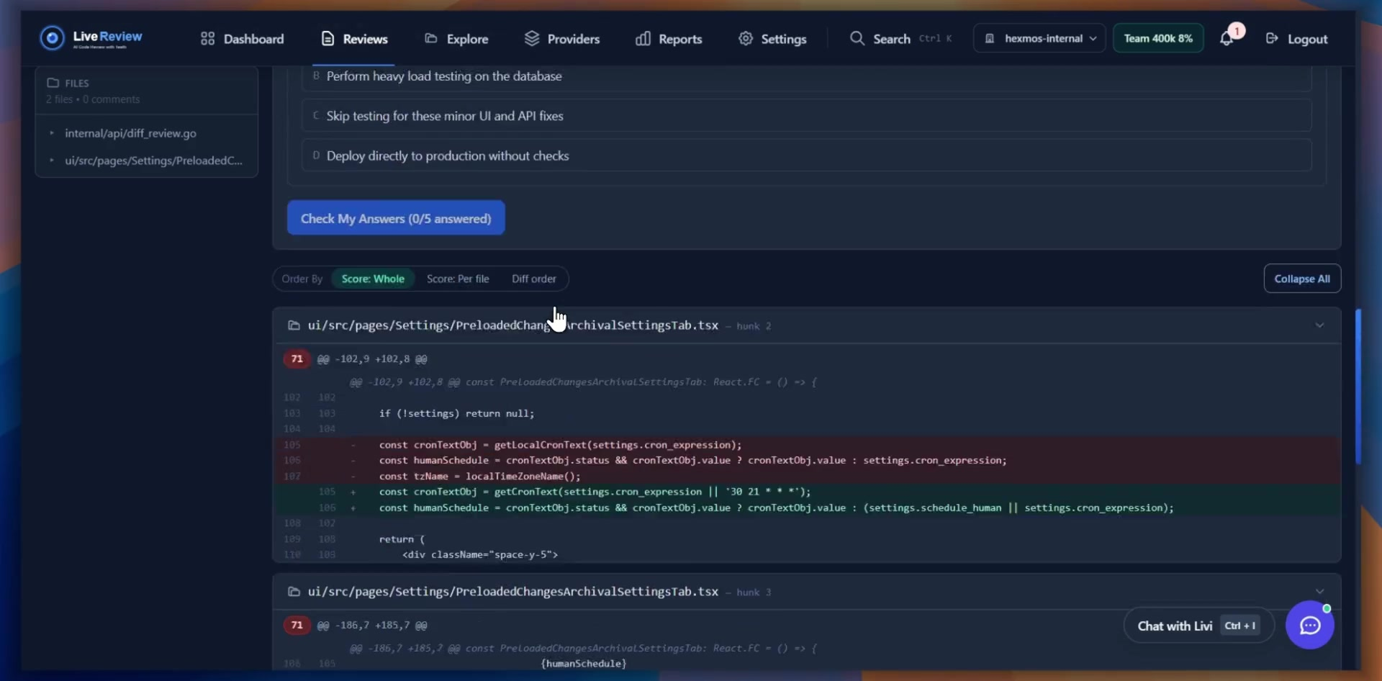
LiveReview
ACT 02 — CONSISTENCY
Check the review
actually landed
A short quiz per review turns a skim into
understanding.
5 questions per review
graded against the diff
Slides · Text · Quiz
three ways to read one review

Slide 13
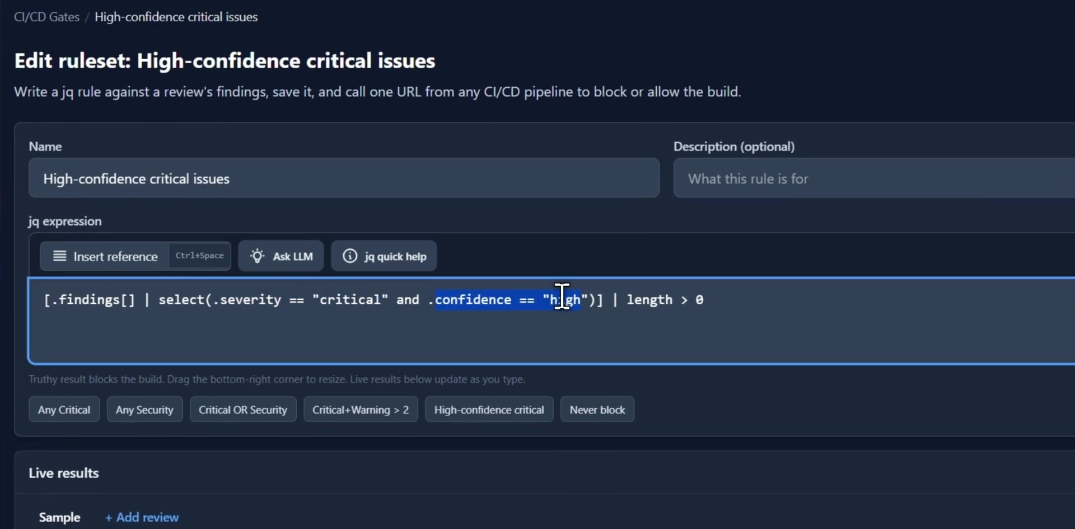
LiveReview
ACT 02 — CONSISTENCY
A gate your pipeline can call
Write a jq rule over a review's findings, save it, and call one URL from any CI/CD pipeline to block or allow the build.

Slide 14
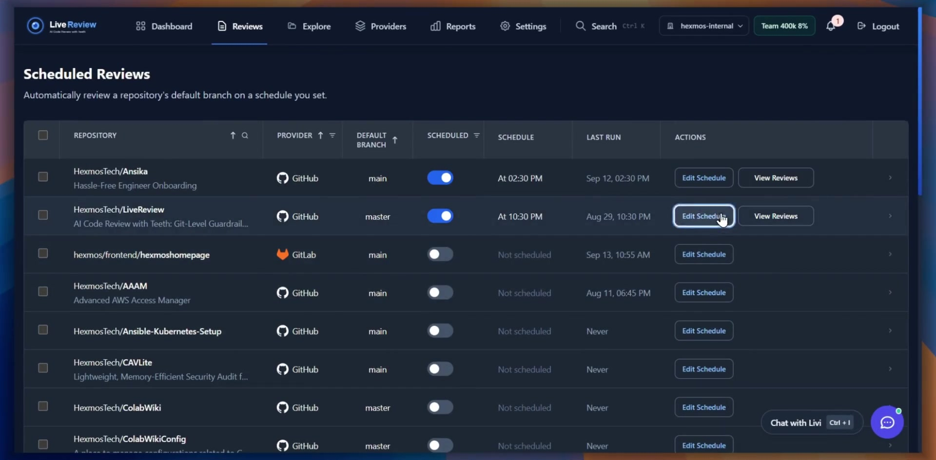
LiveReview
ACT 02 — CONSISTENCY
Reviews that run
without being asked
Point LiveReview at a repository's default
branch and set a time.
Per-repository schedules
GitHub, GitLab and more
Runs on the default branch
main or master, your choice

Slide 15
LiveReview
ACT 03 — CONTROL
THE PROBLEM
Other reviewers send your code outside your
infrastructure, and seat-based monthly pricing can get
expensive.

Slide 16
LiveReview
ACT 03 — CONTROL
THE PROBLEM
Other reviewers send your code outside your
infrastructure, and seat-based monthly pricing can get
expensive.
THE ANSWER
Keep your code in your infrastructure and choose which AI
models inspect it.

Slide 17
LiveReview
ACT 03 — CONTROL
THE PROBLEM
Other reviewers send your code outside your
infrastructure, and seat-based monthly pricing can get
expensive.
THE ANSWER
Keep your code in your infrastructure and choose which AI
models inspect it.
AND ALSO
Adaptive Reviews cut AI cost; Livi learns from reviews; CLI, IDE, MCP and API
fit your workflow.

Slide 18
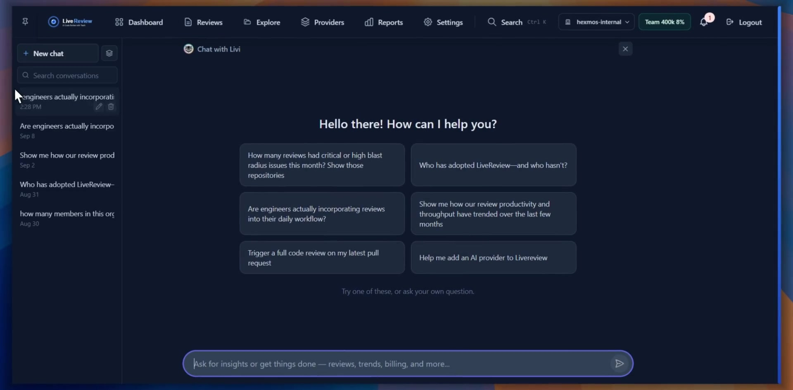
LiveReview
ACT 03 — CONTROL
Ask Livi about your own codebase
Reviews, trends, adoption and billing — answered from your data, inside your infrastructure.

Slide 19
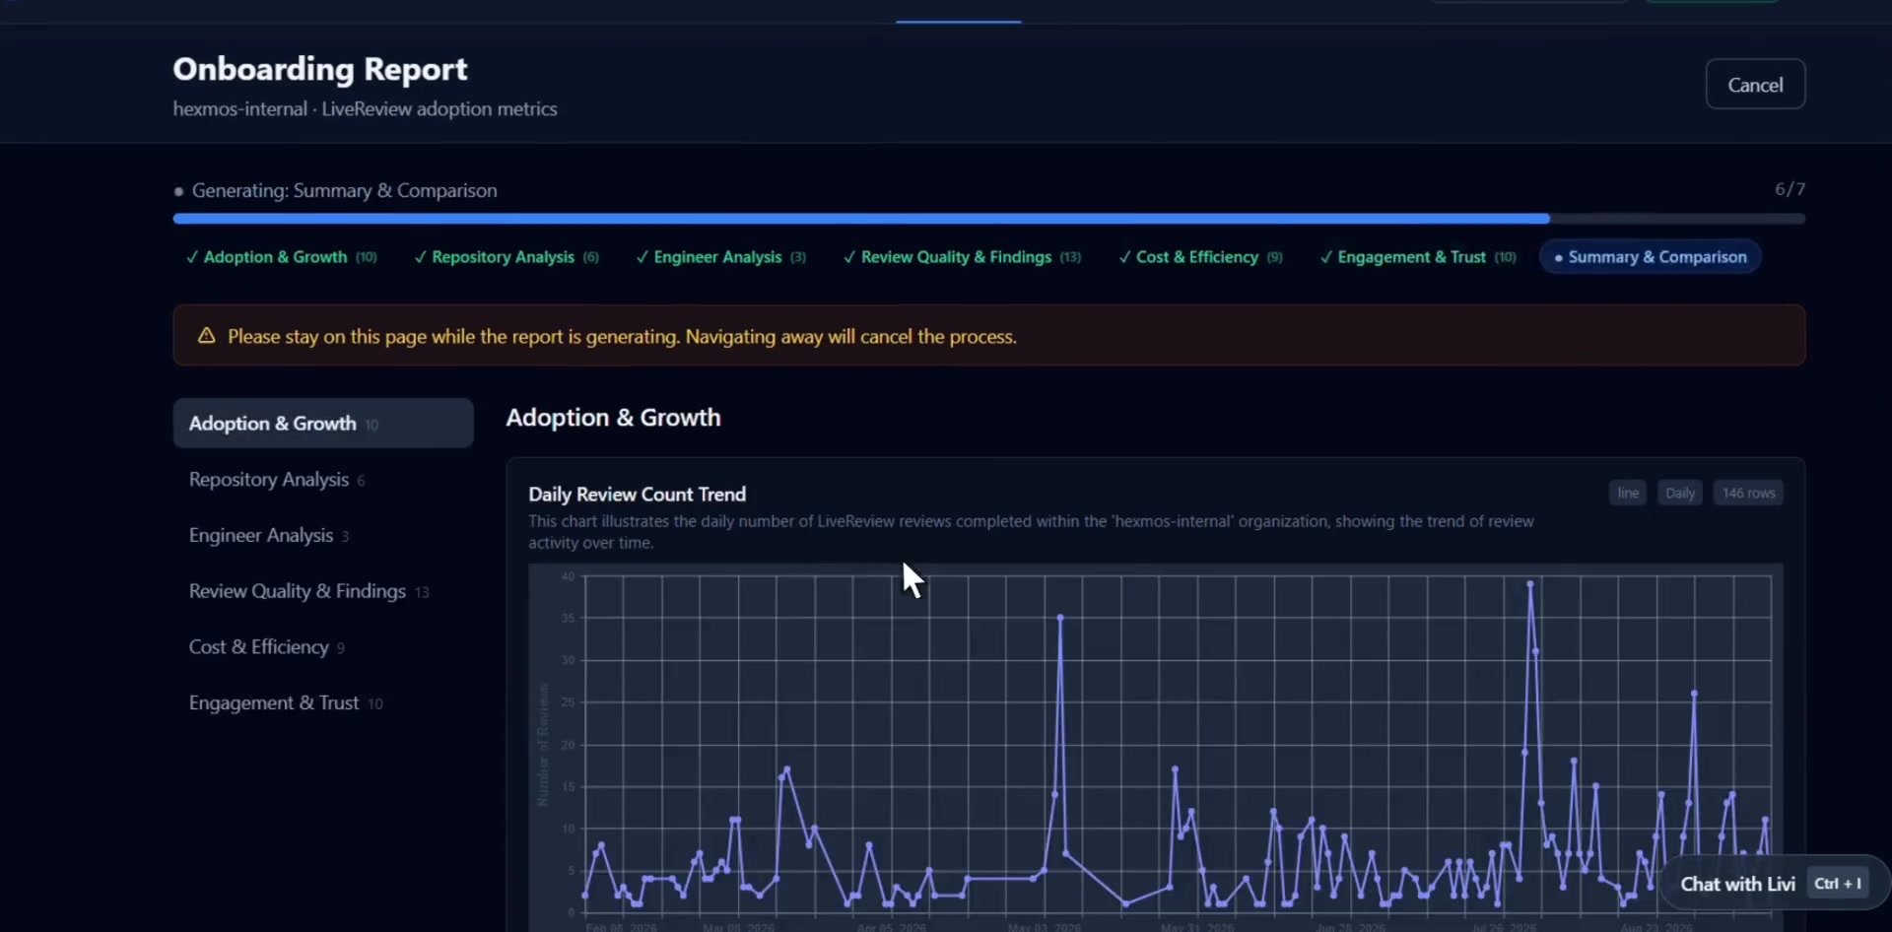
LiveReview
ACT 03 — CONTROL
Onboarding,
measured
A generated report on how your organisation
actually adopted LiveReview.
7 sections
adoption, repositories, engineers, quality
Cost & efficiency
what review actually costs you
Engagement & trust
are findings being acted on

Slide 20
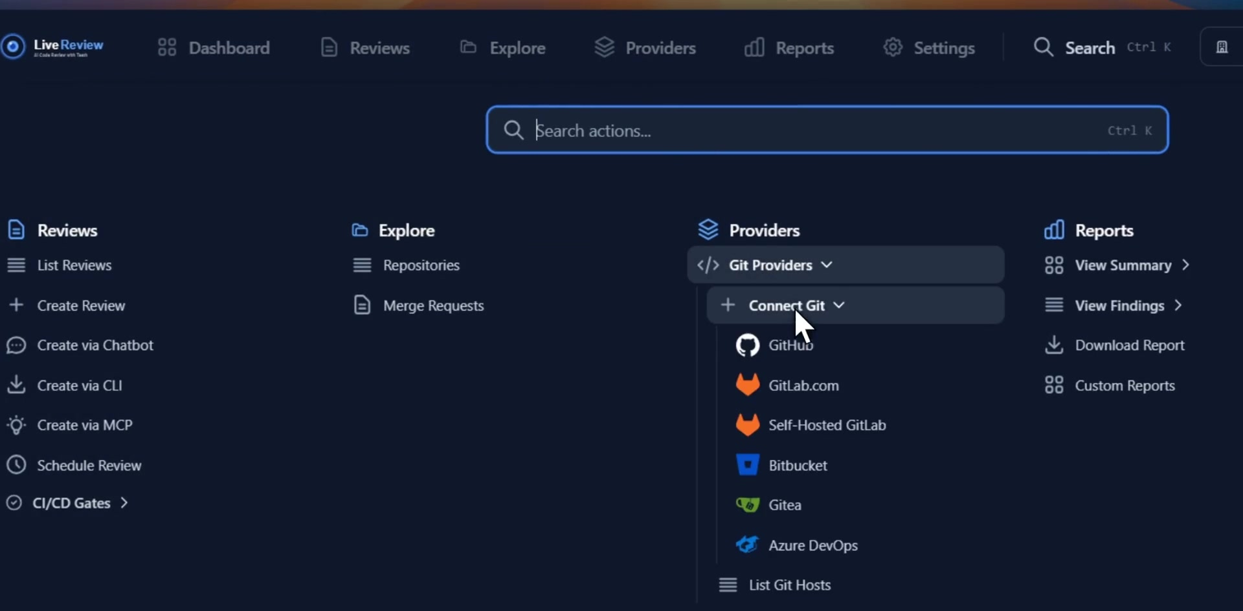
LiveReview
ACT 03 — CONTROL
Everything from one top bar
Reviews, Explore, Providers, Reports and Settings — start a review from the UI, CLI, MCP or chatbot.

Slide 21

LiveReview
Three problems. One reviewer.
01
02
03
Attention
Consistency
Control
Every hunk ranked by blast radius
and review priority.
Reviews at commit, push, PR, CI/CD
and on schedule, enforcing your
rules.
Your code stays in your
infrastructure, and you pick the AI
models that inspect it.
hexmos.com/livereview

